Slide 1

A Presentation on
Digital Language Lab Portal
Presented By
Mr Gadekar Shubham Balu
Mr Pawar Rohit Bahusaheb
Mr Musale Akshay Dadasaheb
B.E. Computer
Under Guidance of
Prof. Darekar .S.A
Shri Chhatrapati Shivaji Maharaj College Of Engineering
Department Of Computer Engineering
2020-21

Slide 2
Overview
Introduction
Problem Statement
Literature survey
Existing system
Proposed model (**Add Architecture)
UML diagrams
Advantages
Limitations
Future Scope
Conclusion
References

Slide 3
Introduction
These is web as well as android application help to conducts schools and colleges in online mode.
These application makes task easy such as upload documents, videos, pdf regarding syllabus and study material.
By using these application teachers get online exam and generate result quick as possible.
Student also conduct missed lectures beyond limit of place and time.
Student conduct live lectures and lecture whose missed due to some reasons. Student get regular notification on app regarding college, department and exam.
Student also conduct exams in online mode and get result quick.
These application also helpful to submit assignment and practical work online to teachers.

Slide 4
Problem Statement
Now a day schools and colleges conduct in online mode so student needed online lectures and documentation regarding syllabus, topics.
These application help to student as well as teachers or faculty to manage online lectures. Teachers provides online pdf, videos, and other documents.
Conduct online exam for student and quick generate results.

Slide 5
Literature Survey
Fakhrurrazi M. Amin, Hanna Sundari
Abstract
The use of technology in language learning has extensively expanded in line with the advancement of technology itself.
However, the investigation into the implementation of video conferences, learning management systems, and mobile applications, particularly during the emergency remote teaching/the Covid-19 pandemic, is still lacking.
This paper presents survey data from three groups of Indonesian EFL students using three different digital learning platforms: Cisco WebEx Meeting video conferencing, Google Classroom learning management system (LMS), and WhatsApp

Slide 6
Existing System
These is web as well as android application help to conducts schools and colleges in online mode.
These application makes task easy such as upload documents, videos, pdf regarding syllabus and study material.
By using these application teachers get online exam and generate result quick as possible.
Student also conduct missed lectures beyond limit of place and time.
Student conduct live lectures and lecture whose missed due to some reasons.
These application also helpful to submit assignment and practical work online to teachers.

Slide 7
Proposed Model
These is web as well as android application help to conducts schools and colleges in online mode.
These application makes task easy such as upload documents, videos, pdf regarding syllabus and study material.
By using these application teachers get online exam and generate result quick as possible. Student also conduct missed lectures beyond limit of place and time.
Student conduct live lectures and lecture whose missed due to some reasons. Student get regular notification on app regarding college, department and exam.
Student also conduct exams in online mode and get result quick.
These application also helpful to submit assignment and practical work online to teachers.

Slide 8
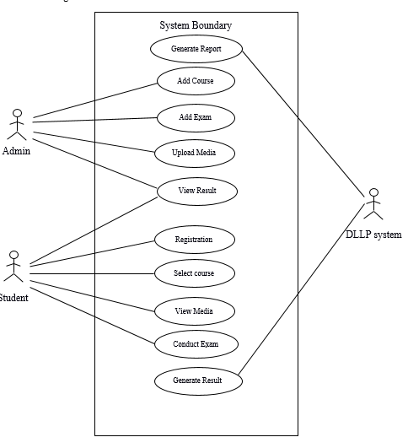
UML Diagram
Use case Diagram

Slide 9
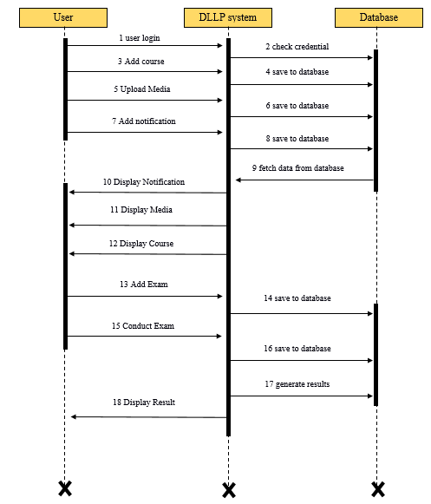
Sequence Diagram

Slide 10
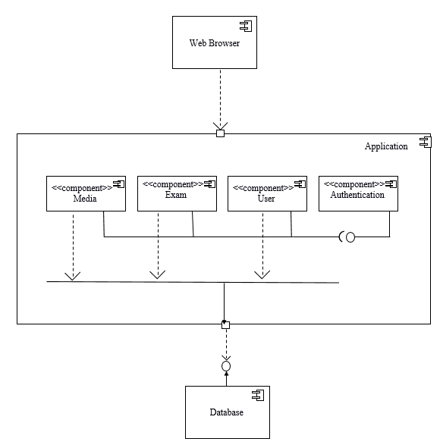
Component Diagram

Slide 11
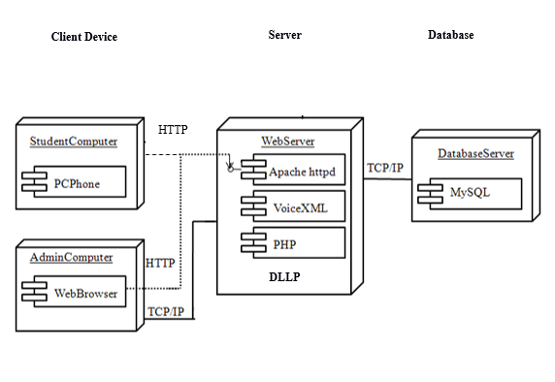
Deployment Diagram

Slide 12
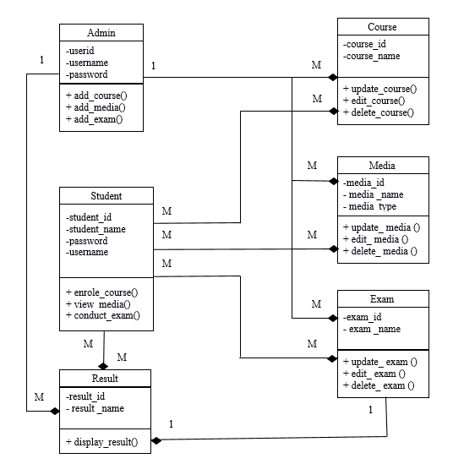
Class Diagram

Slide 13
Advantages
Avoid data loss: This system will help to avoid data loss like students assignment/manual
Anytime anywhere: This portal can be used and accessed anytime and anywhere by students to complete their assignments and submit it.
Time saving: Students can individually login to the portal and submit thier assignments.
Paperless: This system helps to achieve 100% paperless work.

Slide 14
Limitation
All PCs should be in a network.
When PCs are not in same network, internet is required for the connection.
Poor internet connection may affect the speed of the S/W.

Slide 15
Future Scope
Based on the analysis and design of Digital Language Lab Portal, it can be concluded into several points. First, with Online Learning, students have no difficulty in learning.
It is because the material can be obtained through this Digital Language Lab Portal (DLLP). These learning materials can be accessed on the portal.
Second, in Online Learning, the progress of the learning process can be measured through the features of lesson and quiz.
Then, the learning outcomes can be viewed through member dashboard.
For further research, the DLLP can be expanded. For example, it can have discussion forum for users to discuss learning materials. Moreover, the future researcher can add online compiler to check the students’ answer.

Slide 16
Conclusion
This current study was to explore the students’ preferences on digital learning platforms during the emergency remote teaching.
The major finding shows that the student-participants at each group of three digital platforms on the survey, Cisco WebEx Meeting video conferencing, Google Classroom learning management system, and WhatsApp mobile messenger application perceives positive agreement and feel much learning and improvement though it was in an unprecedented situation.
Approximately 44%-61% of the student-participant at each group agreed that the platform they used was beneficial and potential for language learning.

Slide 17
References
Appendix A: Al-Maroof, R. A. S., & Al-Emran, M. (2018). Students’ acceptance of google classroom: An exploratory study using PLS-SEM approach. International Journal of Emerging Technologies in Learning, 13(6), 112-123.
Appendix B: Fakhrurrazi M. Amin, Hanna Sundari
English Teaching Department, State Institute for Islamic Studies (IAIN) Langsa, Langsa 24411, INDONESIA and English Education Department, Indraprasta PGRI University, Jakarta 12530, INDONESIA

